Slide 1

C Structure
BY-ANUJRAJ MOHAPATRA

Slide 2
DEFINITION
Structures (also called structs) are a way to group several related variables into one place. Each variable in the structure is known as a member of the structure.
Unlike an array, a structure can contain many different data types (int, float, char, etc.).
The ,struct keyword is used to define the structure.
Syntax to define a structure:
struct structure_name
{
data_type member1;
data_type member2;
.
.
data_type memeberN;
};

Slide 3
Structure Initialization
Structure variables may be initialized following similar rules of an array. The values are provided within the second braces separated by commas
An example:
struct complex a={1.0,2.0}, b={-3.0,4.0};
a.real=1.0; a.imag=2.0;
b.real=-3.0; b.imag=4.0;

Slide 4
Why use structure?
In C, there are cases where we need to store multiple attributes of an entity. It is not necessary that an entity has all the information of one type only. It can have different attributes of different data types. For example, an entity Student may have its name (string), roll number (int), marks (float). To store such type of information regarding an entity student, we have the following approaches:
Construct individual arrays for storing names, roll numbers, and marks.
Use a special data structure to store the collection of different data types.

Slide 5
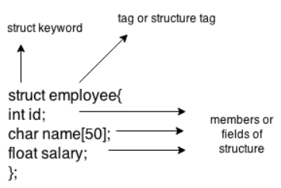
Example to define a structure
struct employee
{ int id;
char name[50];
float salary;
};
Here, struct is the keyword; employee is the name of the structure; id, name, and salary are the members or fields of the structure.

Slide 6
Declaring structure variable
We can declare a variable for the structure so that we can access the member of the structure easily. There are two ways to declare structure variable:
By struct keyword within main() function
By declaring a variable at the time of defining the structure.

Slide 7
Arrays of Structures
Once a structure has been defined, we can declare an array of structures
struct student class[50];
The individual members can be accessed as:
class[i].name
class[5].roll_number
type name

Slide 8
Arrays within Structures
A structure member can be an array
The array element within the structure can be accessed as:
a1.marks[2], a1.dob[3],…
struct student
{
char name[30];
int roll_number;
int marks[5];
char dob[10];
} a1, a2, a3;

Slide 9
Parameter Passing in a Function
Structure variables can be passed as parameters like any other variables. Only the values will be copied during function invocation
void swap (struct complex a, struct complex b)
{
struct complex tmp;
tmp=a;
a=b;
b=tmp;
}

Slide 10
Returning structures
It is also possible to return structure values from a function. The return data type of the function should be as same as the data type of the structure itself
struct complex add(struct complex a, struct complex b)
{
struct complex tmp;
tmp.real = a.real + b.real;
tmp.imag = a.imag + b.imag;
return(tmp);
}
Direct arithmetic operations are not possible with structure variables

Slide 11

THANK YOU

